Slide 1


Slide 2

All Your Cyber Security Needs
Foundation Technology
Our new Anti-Virus protection system
December 2099
Notes:
Here are my notes for this slide
Note 1
2
3
4

Slide 3
Our Life Becomes Incresingly digital
We store data, memories, pictures and personal data on our devices.
Notes:
Content: Our lives are increasingly digital, with critical personal and business data stored online. Visuals: Show an icon and floating data, pictures, etc. As our devices.

Slide 4
Our Life Becomes Incresingly digital
We store data, memories, pictures and personal data on our devices.
Notes:
Content: Our lives are increasingly digital, with critical personal and business data stored online. Visuals: Show an icon and floating data, pictures, etc. As our devices.

Slide 5
Constant growth of Virus Attacks!
Blocked attacks measured between 2080 and 2099 on one example device
No. of attacks in mln
Ever growing
60+ mln
Years

Slide 6
What happens…
20 years
1100%

Slide 7
What happens…
In another 20?

Slide 8
How do we Protect Our Data?
Different ways of protecting your data include caution, software and storage
Being cautious
Trusted storage
solutions
Dedicated software

Slide 9
How do we Protect Our Data?
Different ways of protecting your data include caution, software and storage
Being cautious
Trusted storage
solutions
Dedicated software

Slide 10
How do we Protect Our Data?
Different ways of protecting your data include caution, software and storage
WallSafe
The 100% block-rate anti-virus solution for your devices
Dedicated software

Slide 11
Distinctive features of WallSafe #1
Attacks are stopped before they happen
99%
100%

Slide 12
Unique pricing model
Pay-as you block
Upfront
$1 per 1 mln
$9,99 or more
Capped at $9,99
99% block rate
100% security

Slide 13
Comprehensive
Virus, malware,
Exploits and more
Real-Time
Software always runs in backgrdound
All Devices
Full security
Of your data

Slide 14
Comprehensive
Virus, malware,
Exploits and more
Real-Time
Software always runs in backgrdound
All Devices
Full security
Of your data

Slide 15
Comprehensive
Virus, malware,
Exploits and more
Real-Time
Software always runs in backgrdound
All Devices
Full security
Of your data

Slide 16
Get
Started
Comprehensive
Virus, malware,
Exploits and more
Real-Time
Software always runs in backgrdound
All Devices
Visit website
Full security
Of your data

Slide 17














Our solution is trusted by:

Slide 18
Our solution is trusted by:

Slide 19
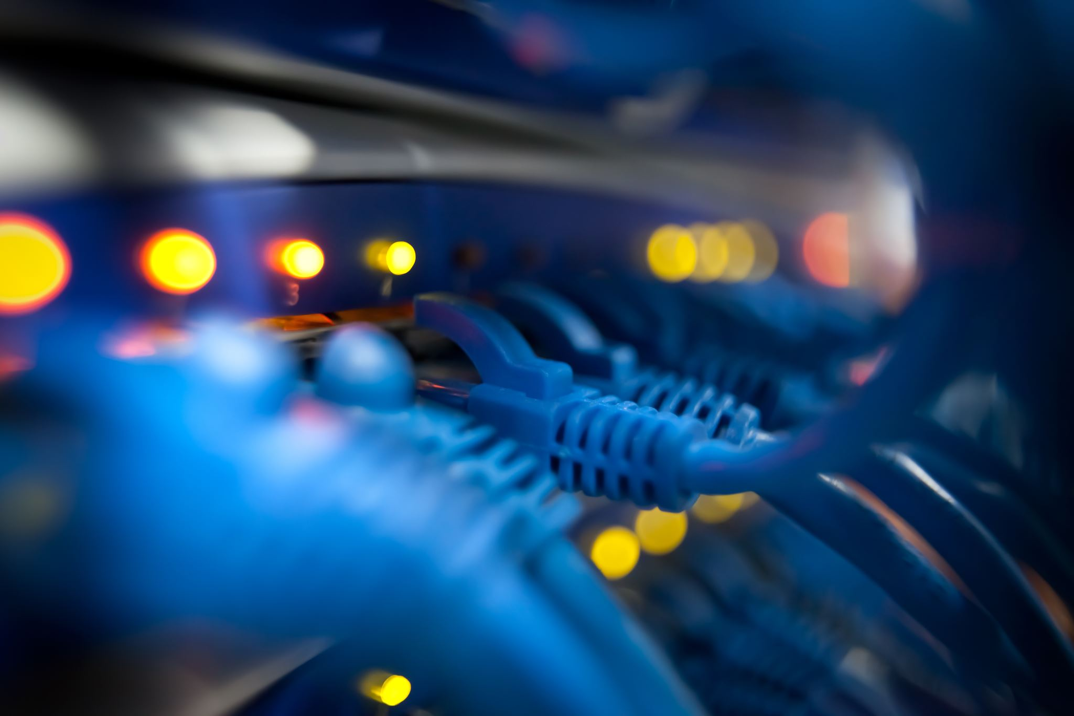


More about Foundation Technology
Get to know us before working with us
We care about the privacy of our users.
Our company takes customer satisfaction
as a priority.
Up to date
Qualified Workforce
Following Trends
Our database is updated
24/7, no failures.
We hire best IT specialist in the filed
We are signed with 3rd party virus update providers

Slide 20
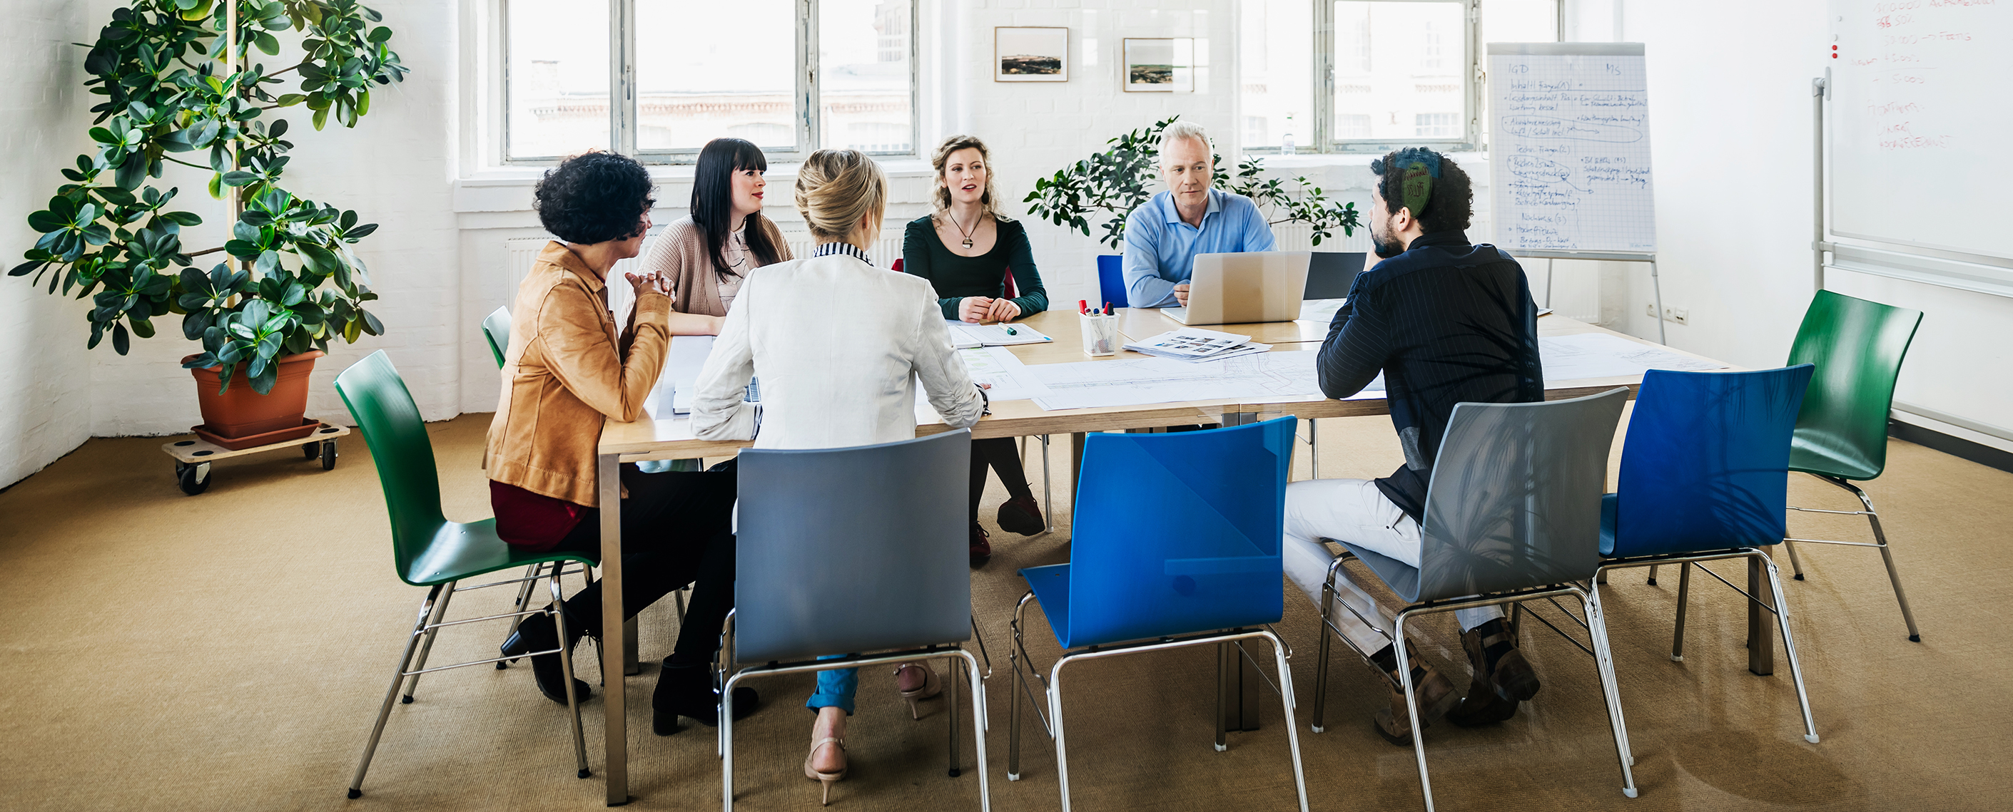
Open to
questions

Slide 21
Thank You
WallSafe
Wall-safe anti virus protection system
December 2099

Slide 22
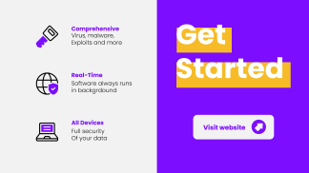
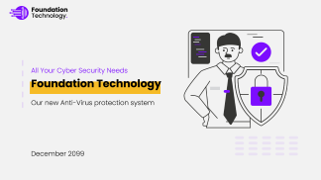
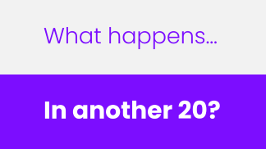
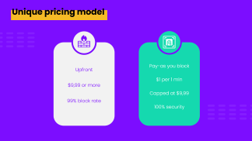



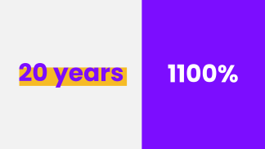
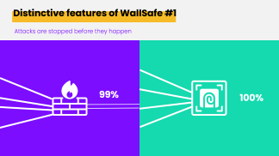
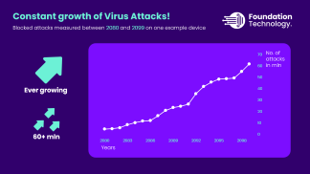
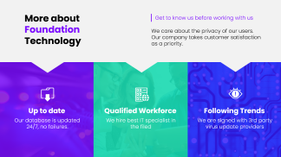

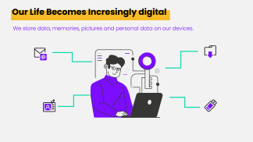
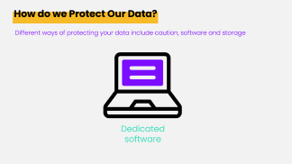

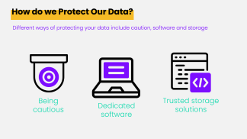

Slide 23
Brand book
#7C0DFF
#9C5EF2
#C4A2F2
#5005F2
#6CF1D6
#15D9AF
#F2F2F2
Roboto, Lato, Poppins, Open Sans, Raleway,

Slide 24
Icons

Slide 25

Logos

